Slide 1
Table of Contents
This slide deck consists of slides used in 2 lecture videos in Week 1. Below is a list of shortcut hyperlinks for you to jump into specific sections.
(page 2) Week 1: Cookies and Sessions
(page 15) Week 1:Django Sessions
Notes:
Note from Chuck. If you are using these materials, you can remove my name and URL from this replace it with your own, but please retain the CC-BY logo on the first page as well as retain the entire last page when you remix and republish these slides.
TO Highlight – go to https://tohtml.com/html/ - paste and then do a "Paste RTF"

Slide 2
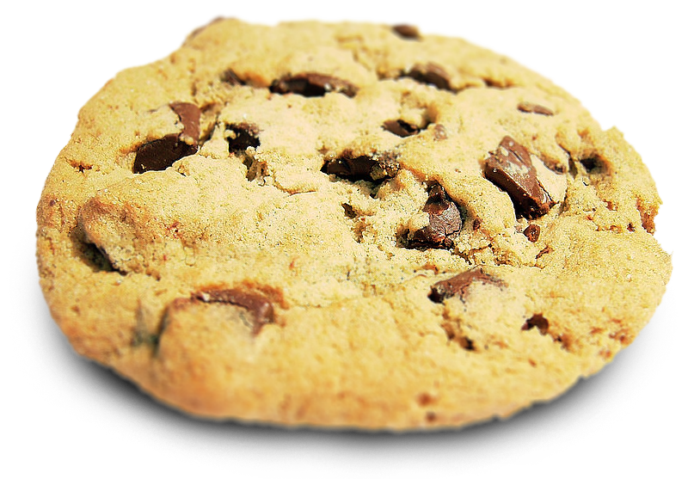

Cookies and Sessions
Charles Severance
www.dj4e.com
https://samples.dj4e.com/session/

Slide 3

Cookies and Sessions
Browser
Linux
D
O
M
N
G
I
N X
WGSIConfig
settings.py
Django
Click
Session
Middleware
Session
Storage
Parse
Response
urls.py
views.py
Templates
Javascript
forms.py
models.py
Database

Slide 4
Multi-User / Multi-Browser
When a server is interacting with many different browsers at the same time, the server needs to know *which* browser a particular request came from.
Request / Response initially was stateless - all browsers looked identical . This was really bad and did not last very long at all.

Slide 5
Web Cookies to the Rescue
Technically, cookies are arbitrary pieces of data chosen by the Web server and sent to the browser. The browser returns them unchanged to the server, introducing a state (memory of previous events) into otherwise stateless HTTP transactions. Without cookies, each retrieval of a Web page or component of a Web page is an isolated event, mostly unrelated to all other views of the pages of the same site.
http://en.wikipedia.org/wiki/HTTP_cookie

Slide 6
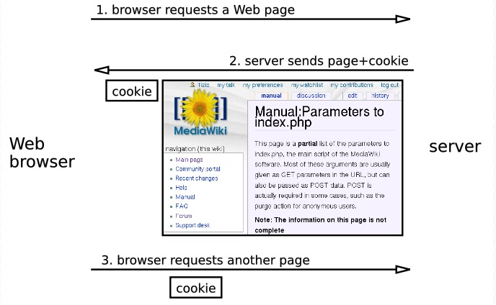
HTTP cookie
http://en.wikipedia.org/wiki/HTTP_cookie

Slide 7
Cookies In the Browser
Cookies are marked as to the web addresses they come from. The browser only sends back cookies that were originally set by the same web server.
Cookies have an expiration date. Some last for years, others are short-term and go away as soon as the browser is closed

Slide 8
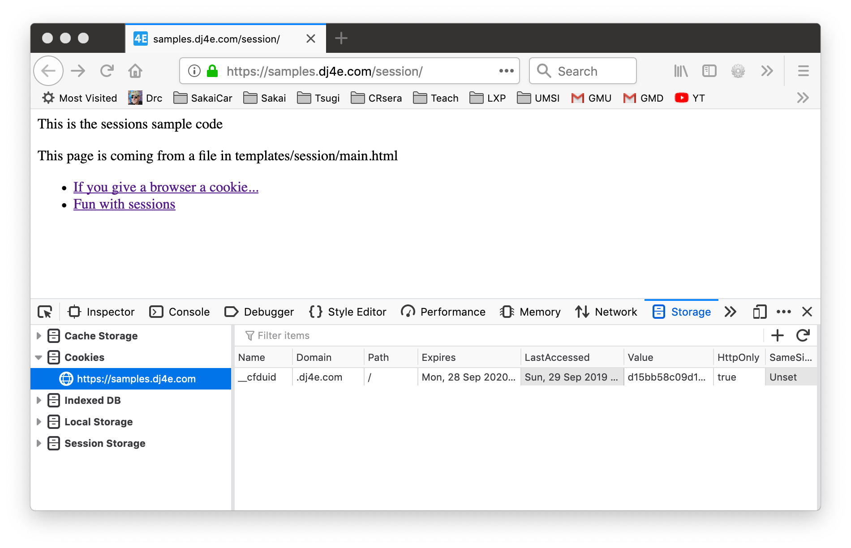
Cookies
https://samples.dj4e.com/session/
https://github.com/csev/dj4e-samples/blob/master/session/home/views.py

Slide 9
Cookies
https://github.com/csev/dj4e-samples/blob/master/session/home/views.py
def cookie(request):
print(request.COOKIES)
resp = HttpResponse('C is for cookie and that is good enough for me...')
resp.set_cookie('zap', 42) # No expired date = until browser close
resp.set_cookie('sakaicar', 42, max_age=1000) # seconds until expire
return resp
In the log:
[29/Sep 23:17:55] "GET /session/cookie HTTP/1.1" 200 26
{'sessionid': 'xy414ikma0p80jw19mrg146inewhzp3s', 'zap': '42', 'sakaicar': '42'}

Slide 10
Cookies
https://samples.dj4e.com/session/
https://github.com/csev/dj4e-samples/blob/master/session/home/views.py

Slide 11
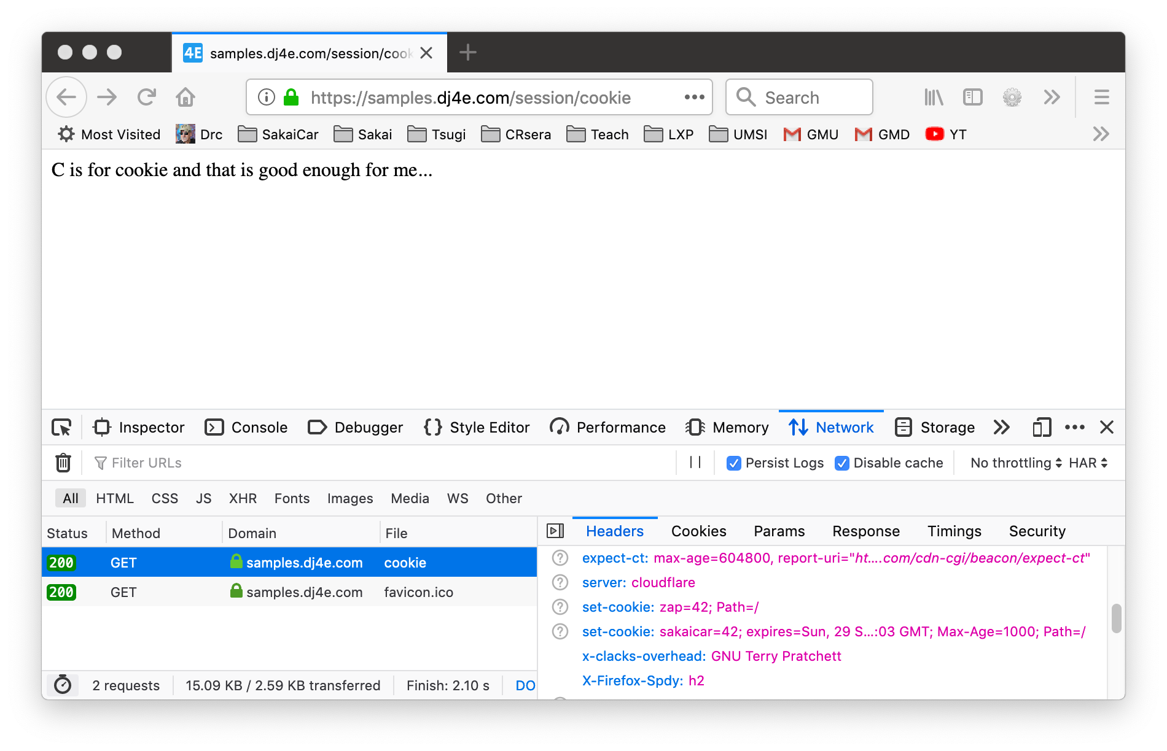
Cookies
def cookie(request):
print(request.COOKIES)
resp = HttpResponse('C is for cookie and that is good enough for me...')
resp.set_cookie('zap', 42) # No expired date = until browser close
resp.set_cookie('sakaicar', 42, max_age=1000) # seconds until expire
return resp

Slide 12
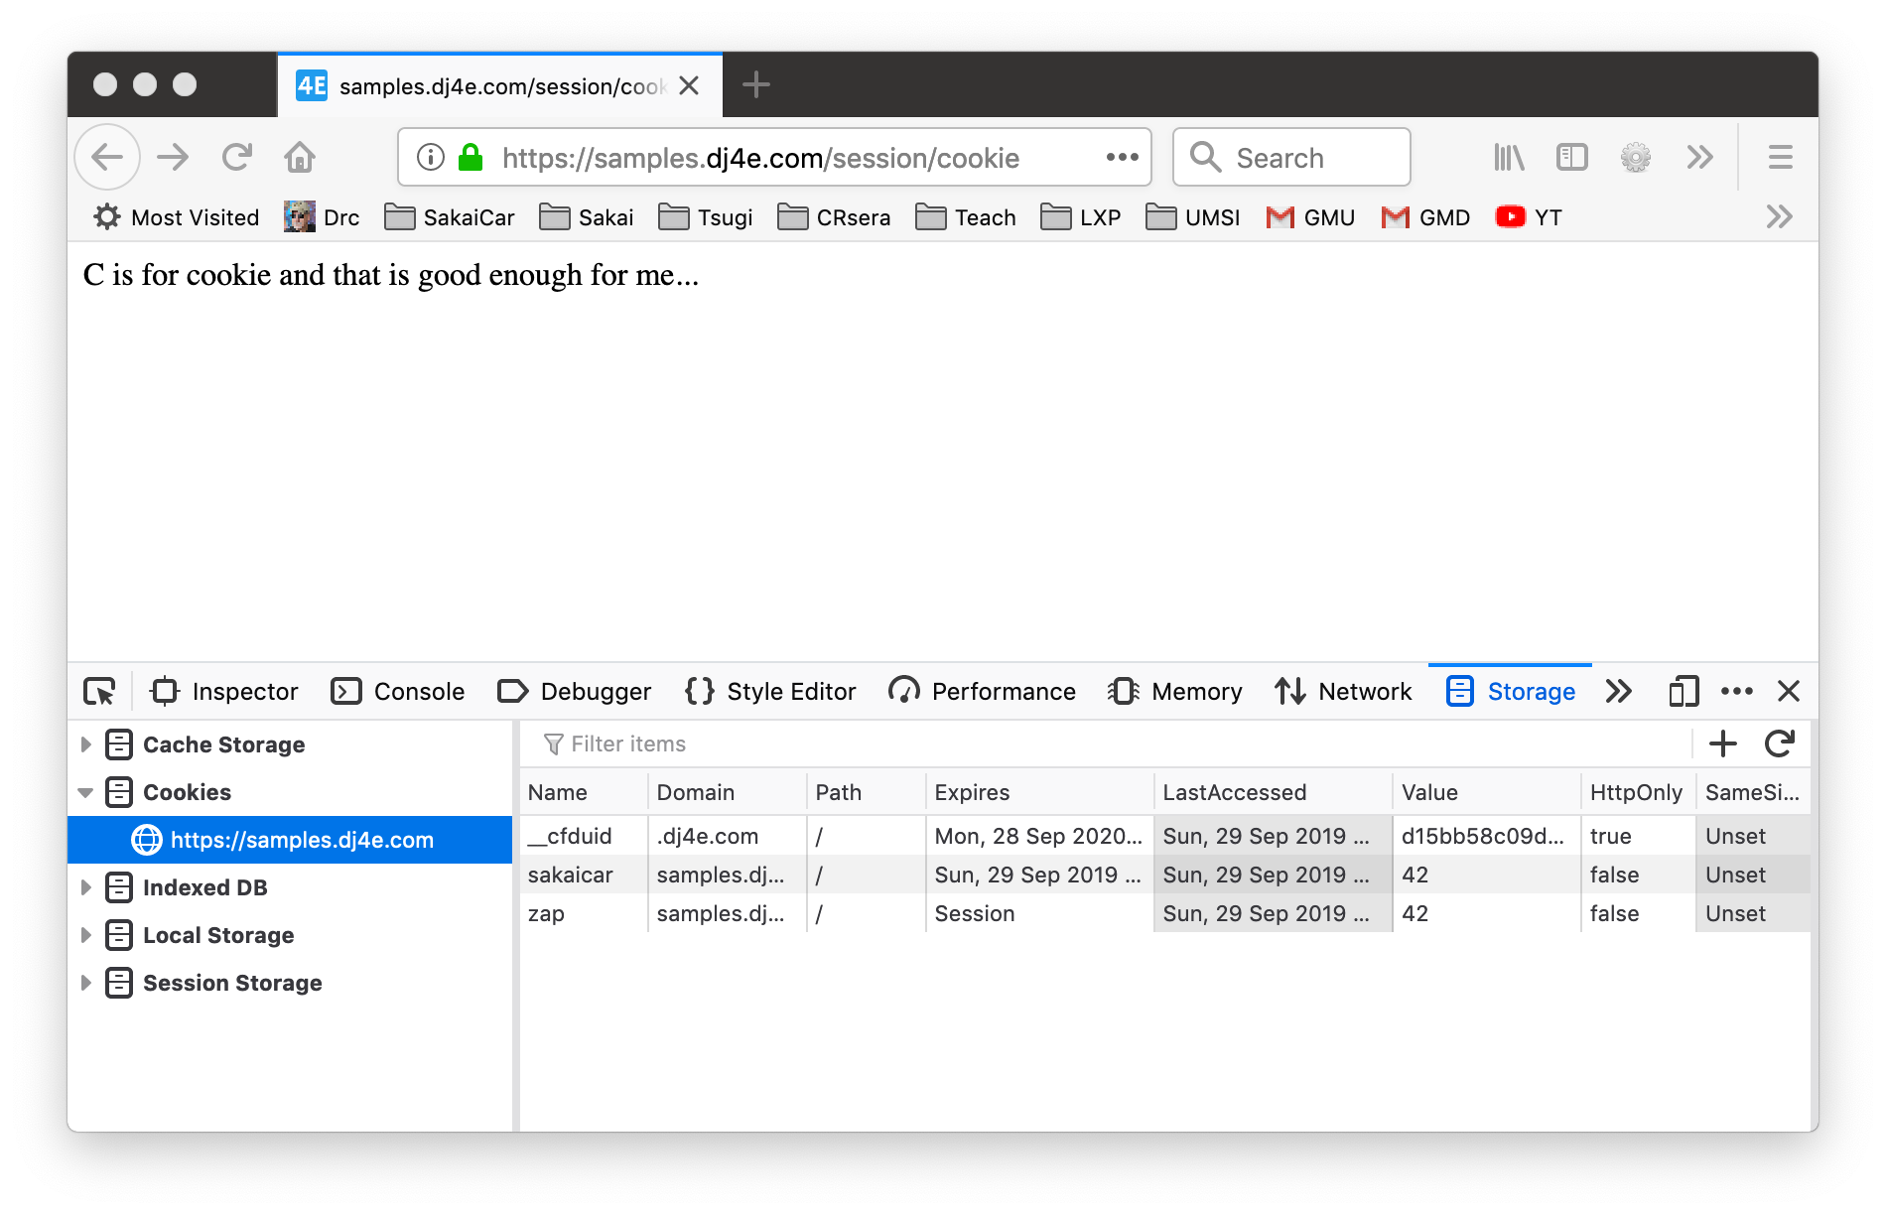
Cookies

Slide 13
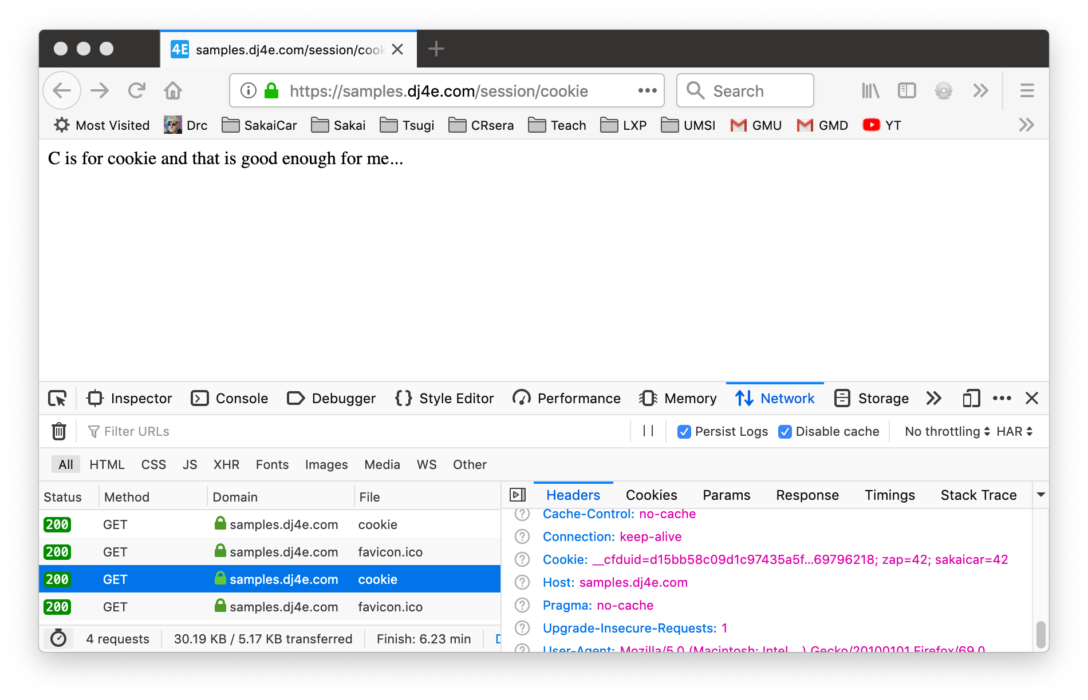
Cookies

Slide 14


Cookies
Time
Browser
Browser zap=42
Browser zap=42
Browser zap=42
zap=42
Apache
set_cookie()
request.COOKIES
request.COOKIES
request.COOKIES
Django
Code

Slide 15
Django Sessions
https://samples.dj4e.com/session/sessfun
https://github.com/csev/dj4e-samples/tree/master/session

Slide 16
Sessions
Browser
Linux
D
O
M
N
G
I
N X
WGSIConfig
settings.py
Django
Session
Middleware
3e
Click
6f
Parse
Response
urls.py
42
views.py
Templates
Javascript
forms.py
models.py
Database
Notes:
Session refer to the cookies come in and grab the particular session associate with it. and so by the time you're coming into one of your urls.py, one of your views from urls.py,what you'll find is that cookies have all been set, the session has been set up.
If no cookie comes in, the session will pick up a large random number and create a new session and send cookie back

Slide 17
In the Server - Sessions
In most server applications, as soon as we start a session for a new (unmarked) browser we create a session.
We set a session cookie to be stored in the browser, which indicates the session id in use – gives this browser a unique “mark”.
The creation and destruction of sessions is handled by a Django middleware that we use in our applications.

Slide 18
Session Identifier
A large, random number that we place in a browser cookie the first time we encounter a browser
This number is used to pick from the many sessions that the server has active at any one time.
Server software stores data in the session that it wants to have from one request to another from the same browser.
Shopping cart or login information is stored in the session in the server.

Slide 19
Middleware
MIDDLEWARE = [
'django.middleware.security.SecurityMiddleware',
'django.contrib.sessions.middleware.SessionMiddleware',
'django.middleware.common.CommonMiddleware',
'django.middleware.csrf.CsrfViewMiddleware',
'django.contrib.auth.middleware.AuthenticationMiddleware',
'django.contrib.messages.middleware.MessageMiddleware',
'django.middleware.clickjacking.XFrameOptionsMiddleware',
]
https://github.com/csev/dj4e-samples/blob/master/dj4e-samples/settings.py

Slide 20
Default – Store Sessions in the Database
$ python3 manage.py migrate
Operations to perform:
Apply all migrations: admin, auth, contenttypes, sessions
Running migrations:
Applying contenttypes.0001_initial... OK
Applying auth.0001_initial... OK
Applying admin.0001_initial... OK
Applying admin.0002_logentry_remove_auto_add... OK
...
Applying auth.0009_alter_user_last_name_max_length... OK
Applying sessions.0001_initial... OK

Slide 21
Sessions
Space
Browser S=A123
Browser S=B345
Browser S=C678
Web Server
Django Session Middleware
A123
B345
C678

Slide 22
Sessions
Time
Browser S=C123
Browser S=C123
Browser S=C123
Browser S=C123
Django
request
POST
session
request
GET
session
request
POST
session
...
request
POST
session
C123

Slide 23
Django Sessions
The incoming request object has a request.session attribute that we can treat like a dictionary that persists from one request to the next request
As long we have the session middleware enabled in settings.py and the database table, and the browser allows cookies, we just store and read request.session in our views and pretend it is "magic"

Slide 24
Sessions
def sessfun(request) :
num_visits = request.session.get('num_visits', 0) + 1
request.session['num_visits'] = num_visits
if num_visits > 4 : del(request.session['num_visits'])
return HttpResponse('view count='+str(num_visits))
https://github.com/csev/dj4e-samples/blob/master/session/views.py

Slide 25
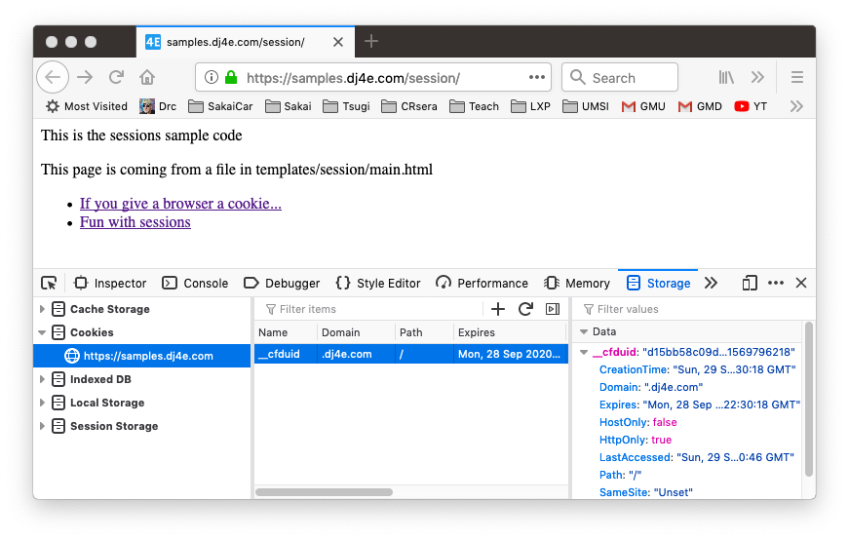
Sessions
https://github.com/csev/dj4e-samples/blob/master/session/views.py

Slide 26
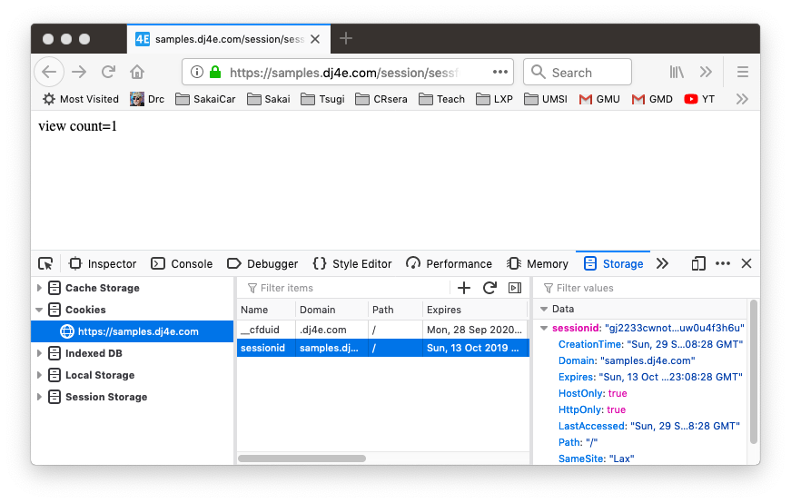
Sessions

Slide 27

Sessions

Slide 28
Sessions
$ sqlite3 db.sqlite3
SQLite version 3.24.0 2018-06-04 14:10:15
Enter ".help" for usage hints.
sqlite> .tables
auth_group auth_user_user_permissions
auth_group_permissions django_admin_log
auth_permission django_content_type
auth_user django_migrations
auth_user_groups django_session
sqlite> .mode column
sqlite> select * from django_session;
vosaoain2dzw0o8bzlgsmovdbkp574us
YThiZWRjMjQ1NzZhMzYzMTBhZjYxNWI2ZDgyODI1Y2ExODI2MTJjNzp7Im51bV92aXNpdHMiOjF9
2019-02-21 15:18:34.995362
vii016kh2vzqpm0uw3or4qrqxddmwisx
OWNkOGQxYjg4NzlkN2ZhOTc2NmU1ODY0NWMzZmQ4YjdhMzM4OTJhNjp7Im51bV92aXNpdHMiOjJ9
2019-02-21 15:32:52.555061
sqlite> .quit

Slide 29
What is in the Django Session Table?
$ python3
>>> import base64
>>> x = base64.b64decode(
... 'OWNkOGQxYjg4NzlkN2ZhOTc2NmU1ODY0NWMzZmQ4YjdhMzM4OTJhNjp7Im51bV92aXNpdHMiOjJ9')
>>> print(x)
b'9cd8d1b8879d7fa9766e58645c3fd8b7a33892a6:{"num_visits":2}'
>>> import json
>>> data = json.loads(x[41:])
>>> print(data)
{'num_visits': 2}
>>>

Slide 30
Summary
HTTP Cookies
Sessions
Using Sessions in Django

Slide 31
Acknowledgements / Contributions
These slides are Copyright 2010- Charles R. Severance (www.dr-chuck.com) as part of www.wa4e.com and made available under a Creative Commons Attribution 4.0 License. Please maintain this slide in all copies of the document to comply with the attribution requirements of the license. If you make a change, feel free to add your name and organization to the list of contributors on this page as you republish the materials.
Initial Development: Charles Severance, University of Michigan School of Information
Insert new Contributors and Translators here including names and dates
Continue new Contributors and Translators here
Notes:
Note from Chuck. Please retain and maintain this page as you remix and republish these materials. Please add any of your own improvements or contributions.

Slide 32
Additional Source Information
Cookie Image: By brainloc on sxc.hu (Bob Smith) (stock.xchng) [CC BY 2.5 (http://creativecommons.org/licenses/by/2.5)], via Wikimedia Commons
Portions of the text of these slides is adapted from the text www.djangoproject.org web site. Those slides which use text from that site have a reference to the original text on that site. Django is licensed under the three-clause BSD license.

